Slide 1

Geometry
Unit 10, Lesson 6 Solving Problems Involving Inscribed Angles Volume 2, pg. 148

Slide 2


Benchmark
MA.912.GR.6.2
Solve mathematical and real-world problems involving the measures of arcs and related angles.
volume 2, pg. 148

Slide 3
Integrated Mathematical Thinking and Reasoning Standards
MA.K12.MTR.1.1 Actively participate in effortful learning both individually and collectively.
MA.K12.MTR.2.1 Demonstrate understanding by representing problems in multiple ways.
MA.K12.MTR.4.1 Engage in discussions that reflect on the mathematical thinking of self and others.
MA.K12.MTR.5.1 Use patterns and structure to help understand and connect mathematical concepts.
MA.K12.MTR.6.1 Assess the reasonableness of solutions.
volume 2, pg. 148

Slide 4

Learning Target
I can use the relationship between the measure of an inscribed angle and its intercepted arc to solve problems.
volume 2, pg. 148

Slide 5

Warm-Up
volume 2, pg. 148

Slide 6
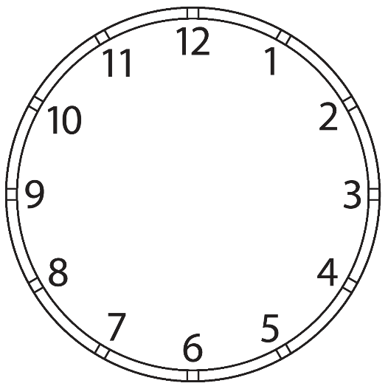

10.6.1 Warm-Up: Angles on a Clock
Use the clock to answer the following questions.
If the time is $10:10$ and the hour hand does not move, what is the exact angle between the minute hand and hour hand?
volume 2, pg. 148

Slide 7
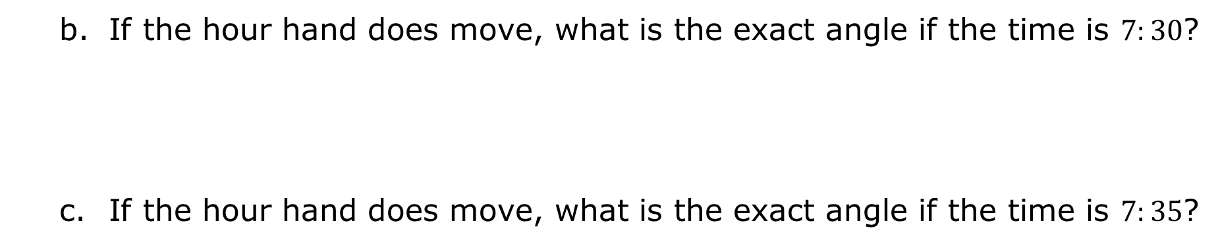
If the hour hand does move, what is the exact angle if the time is $7:30$?
If the hour hand does move, what is the exact angle if the time is $7:35$?
volume 2, pg. 148

Slide 8

Exploration
volume 2, pg. 149

Slide 9


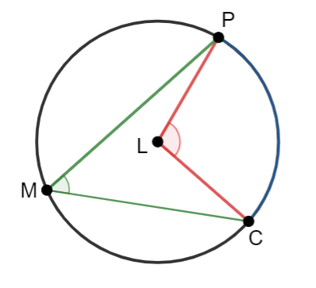
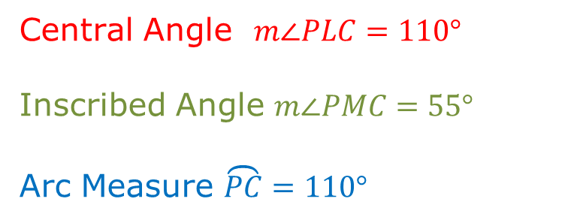
10.6.2 Exploration: Inscribed Angles
Circle $L$ is shown where $P$, $C$, and $M$ are points on the circle.
A chord is a line segment on the interior of a circle with both endpoints lying on the circle.
An inscribed angle in a circle is an angle which is formed in the interior of a circle when two chords share an endpoint.
Central Angle $m∠PLC=110°$
Inscribed Angle $m∠PMC=55°$
Arc Measure $\overset{⏜}{PC}=110°$
volume 2, pg. 149

Slide 10
What is the connection between the central angle and the arc measure?
Describe the relationship between the central angle and the inscribed angle.
Write a conclusion about the measures of the central angle, the inscribed angle, and the arc measure.
volume 2, pg. 149

Slide 11
Share your response to Part C with two classmates. Listen to their conclusion and summarize it in the table. You are the only person who should write in the first column of the table. Have the person initial next to your summary stating your summary was correct.
My Summary of Their Conclusion | Initials
volume 2, pg. 149

Slide 12
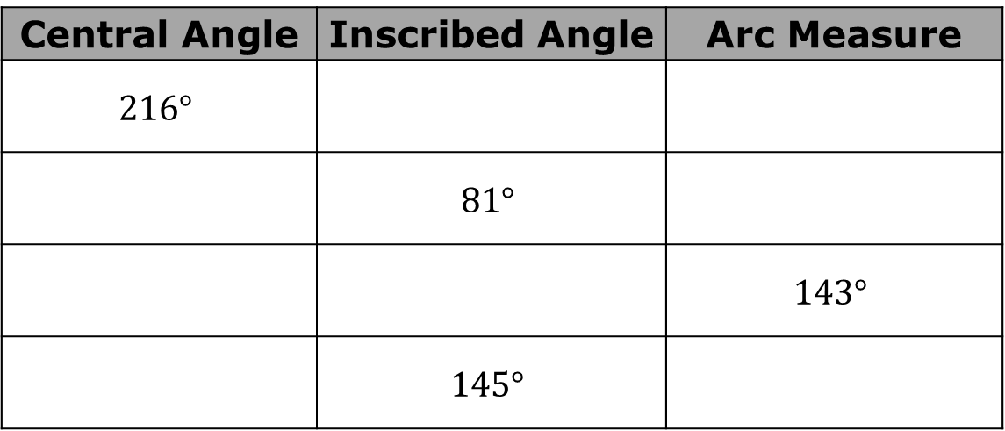
Using Circle $L$, complete the table.
Central Angle | Inscribed Angle | Arc Measure
$$216°$$
 | $$81°$$
 |  | $$143°$$
 | $$145°$$
volume 2, pg. 149

Slide 13
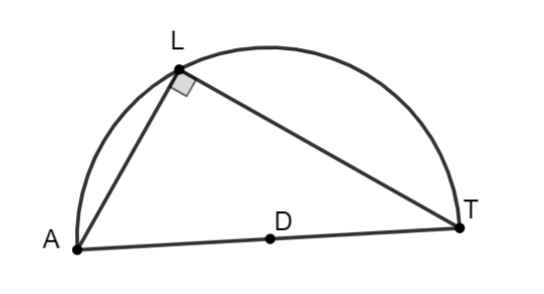

$∠ALT$ is inscribed in semicircle $D$, as shown.
Describe the angle inscribed in the semicircle.
volume 2, pg. 150

Slide 14
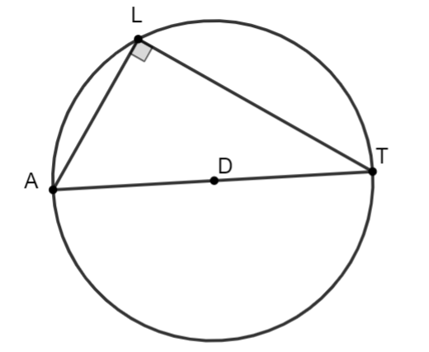

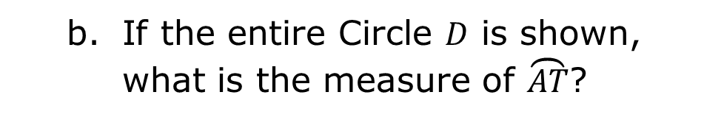
If the entire Circle $D$ is shown, what is the measure of $\overset{⏜}{AT}$?
Discuss with your partner the relationship between an inscribed angle and a semicircle.
Inscribed Angle Theorem
The measure of an inscribed angle is one-half the measure of the intercepted arc.
volume 2, pg. 150

Slide 15

Guided Practice
volume 2, pg. 150

Slide 16

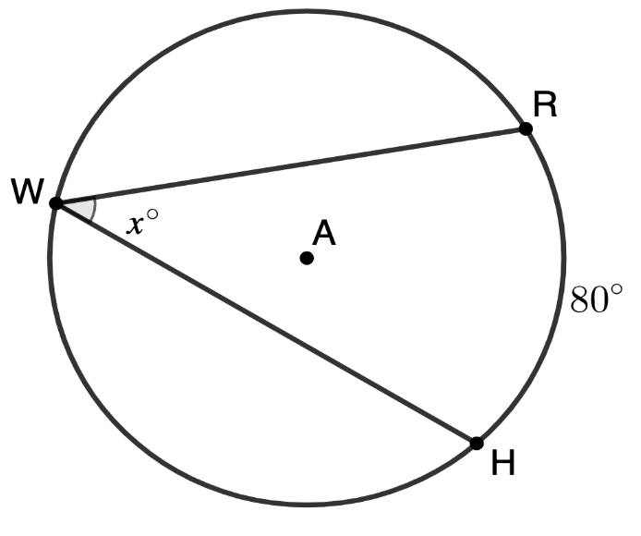
10.6.3 Guided Practice: Inscribed Angles
Circle $A$ is shown where points $R$, $W$, and $H$are on the circle. $∠RWH$ is inscribed inside Circle $A$ with $m\overset{⏜}{RH}=80°$. Find the value of $x.$
volume 2, pg. 150

Slide 17
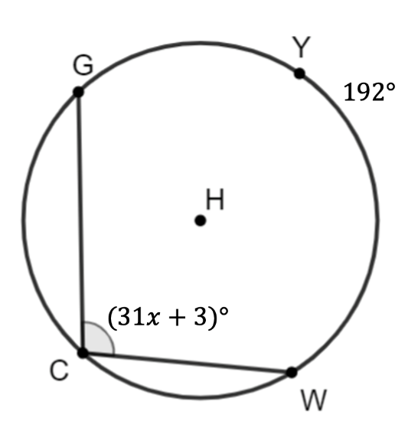
Points $Y$, $G$, $C$, and $W$ lie on Circle $H.$ $∠GCW$ is inscribed in the circle. Find $x$, given $m\overset{⏜}{GYW}=192°$ and $m∠GCW=(31x+3)°$.
volume 2, pg. 150

Slide 18
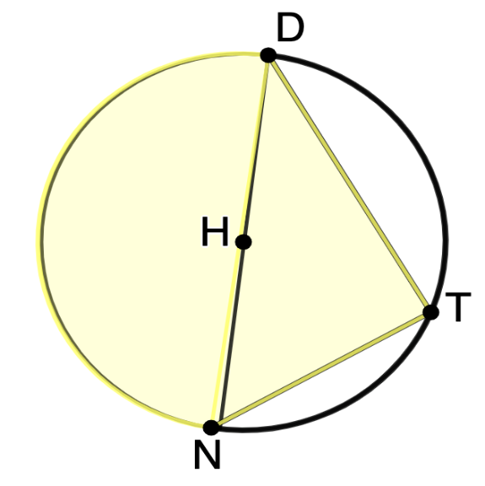


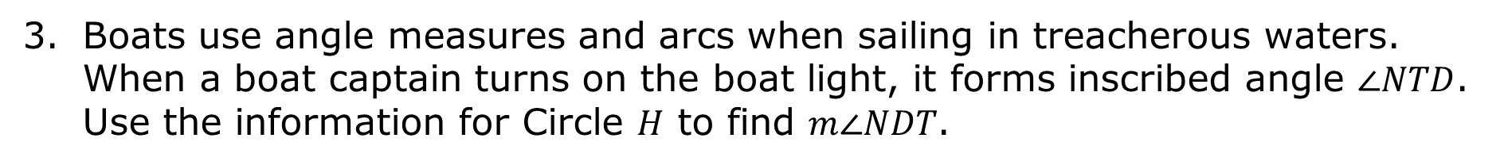

Boats use angle measures and arcs when sailing in treacherous waters. When a boat captain turns on the boat light, it forms inscribed angle $∠NTD$. Use the information for Circle $H$ to find $m∠NDT$.
$$(13x−10)°$$
$$(7x−10)°$$
volume 2, pg. 151

Slide 19
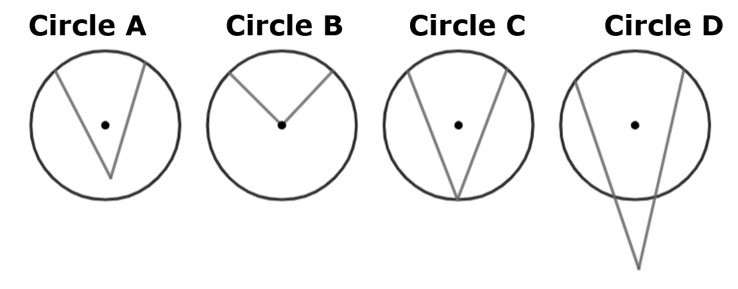
Craig and Valentina are reviewing circles to identify inscribed angles.
Valentina identified Circle C is an inscribed angle. Craig identified both Circle A and Circle C as inscribed angles.
Do you agree with Valentina, Craig, or neither? Justify your reasoning.
volume 2, pg. 151

Slide 20

Your Turn
volume 2, pg. 152

Slide 21
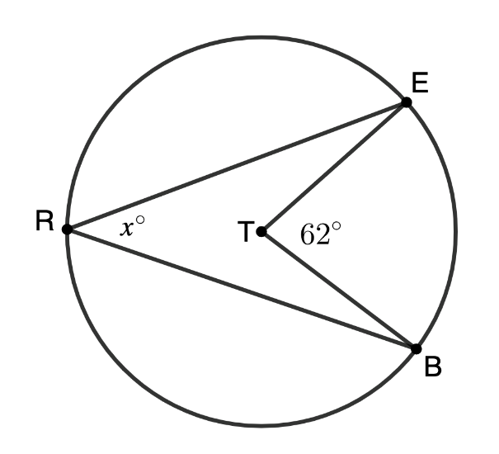
10.6.4 Your Turn!
Circle $T$ is shown where $∠ETB$ is a central angle, $∠ERB$ is inscribed in the circle, and $m∠ETB=62°$. Find $m∠ERB$.
volume 2, pg. 152

Slide 22
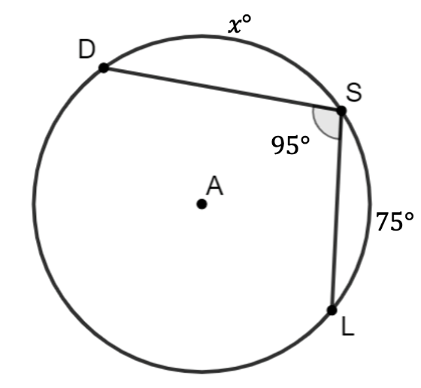
Circle $A$ has points $D$, $S$, and $L$ on the circle. $∠DSL$is inscribed in Circle $A$ measuring $95°$. Given $m\overset{⏜}{SL}=75°$, find $m\overset{⏜}{DS}.$
volume 2, pg. 152

Slide 23
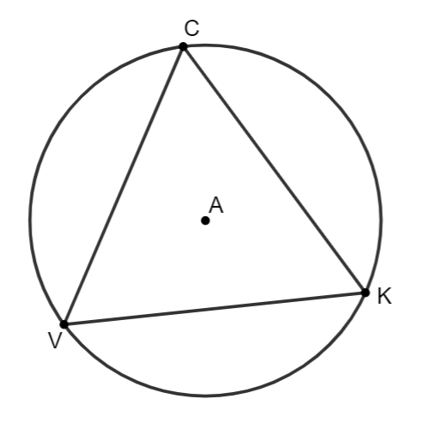
Equilateral triangle $CKV$ is inscribed in Circle $A$. Circle $A$ consists of three equal inscribed angles. Determine the value of the inscribed angle.
volume 2, pg. 152

Slide 24

Wrap-Up
volume 2, pg. 153

Slide 25

10.6.5 Wrap-Up: Reflection
What was the muddiest (most difficult or confusing) point in today’s lesson on solving problems using the relationship between the measure of an inscribed angle and its intercepted arc?
volume 2, pg. 153

